Slide 1
Some thoughts and suggestions:
Showing a figure with the interpreted position of the spring and summer jet/rain bands from 7 to 1 Ma connects the oxygen and carbon isotope records through a single mechanism. I think we should include such a figure. In fact, I think we might consider titling the paper something like ”Westerly jet transition explains Plio-Pleistocene climate and envrionmental change across East Asia"
I suggest we draw the position of the summer rain band such that when it crosses the latitude of a given site, that is when C4 abundance reaches its maximum value.
Following this suggestion, it makes sense to me that the summer rain band hovered around the U1430 source latitude and was at persistently higher latitude than Lingtai until the Pleistocene.
In order to explain BOTH 1) substantial changes in Pliocene summer/spring rain ratio across the CLP (to explain our d18O data) AND 2) C4 migration as considered in the bullets above, I had to make the variation in the latitude of the April westerly jet LARGER than the variation in the latitude of the summer jet. THIS MAKES SENSE! In the modern climate, the jet jumps across the Tibetan Plateau during spring- meaning its position during spring is especially sensitive (e.g., to the MTG). I wonder if this is borne out in Pliocene climate models – in other words, do we see larger shifts from preindustrial (OR from LGM) in the mean position of the jet during April than during July or August?
The configuration as I have drawn it explains most of our observations. But it does not explain 1) why Lingtai d18Osw values are lower than Jiaxian or Shilou at ~4 and 5.5 Ma or 2) some of the smaller shifts in d13C values including the apparent C4 pulse across the CLP at 3.5 Ma when MTG and d18O suggest spring rain.
Some other ideas to improve figure:
Could we express ΔSST instead as MTG (e.g., divide by approx. difference in latitude between sites)? Many people will look at ΔSST and think it is change from modern. More importantly, that might also allow us to extend the MTG curve forward in time through the Pleistocene (using other data sets?), which would be helpful to see here because it would (I’m pretty sure) support the inference that the summer rain band migrated equatorward during the Pleistocene.
Do you think it would make sense to use a smoothed version of the MTG as the summer rain band curve? With the obliquity amplitude used to draw the size of the variation envelope around the the MTG?
The latitude of the U1430 source could be shown to expand through time (as you explain in the text and as I show schematically here- my representation may be wrong).

Slide 2
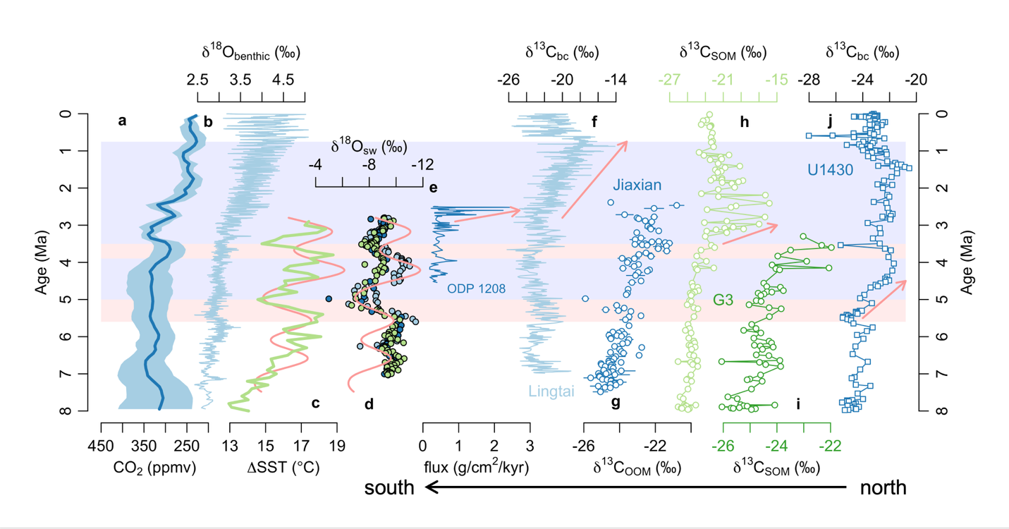
latitude
U1430 source
ODP 1208
G3 source
Lingtai
Jiaxian
Max C4 Lingtai
Variability envelope
(include?)
Max C4 G3 latitude
Apr jet at 1208 latitude
Spring rain CLP
small obliquity amplitude
More Summer rain CLP
Spring rain CLP
Large obliquity amplitude
More Summer rain CLP
C4 expansion in Pakistan (not yet reached East Asia?)
April jet
Summer jet/ rain band (based on MTG)
Jiawei, this is an older version of the figure, but I worked from this one because I think it is important to show our interpreted position of the April and summer westerly jet through the entire interval in one figure. Doing that emphasizes that the jet transition explains a number of observations and, I think, makes for the most convincing argument.

Slide 3
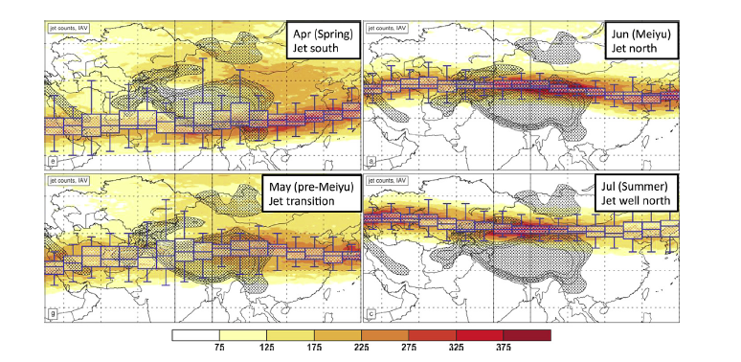
The jet moves a lot in spring- therefore, spring jet position is likely quite senstivite to MTG. In a warmer climate, April position could look like June.
Jet occurrence:
westerly, local max
in vert. column,
> 30 m/s
Total jet occurrences:
Schiemann 2009 , Chiang et al 2015
Notes:
Ok, so now lets look at Asia. This plot shows the seasonal shift in the latitude of the westerly jet. In Asia, the shift is especially large because the Tibetan Plateau deflects the jet. We are particularly interested in eastern Asia, so lets zoom in there

